Slide 1
Mapping ER to Relational Model
Rupa Mehta
COED, SVNIT

Slide 2
Binary Relationship
ER-to-Relational Mapping Algorithm
Mapping of Strong Entity sets
Mapping of Weak Entity sets
Mapping of Binary 1:1 Relation sets
Mapping of Binary 1:N Relationship sets
Mapping of Binary M:N Relationship sets
Mapping of Multivalued attributes
Mapping of N-ary Relationship ses
Mapping EER Model Constructs
Options for Mapping Specialization or Generalization.
Mapping of Union Types (Categories).

Slide 4
1. Mapping of Strong Entity sets
For each strong entity set create a relation R
R includes all the attributes
Choose one of the key attributes of E as primary key for R.

Slide 6
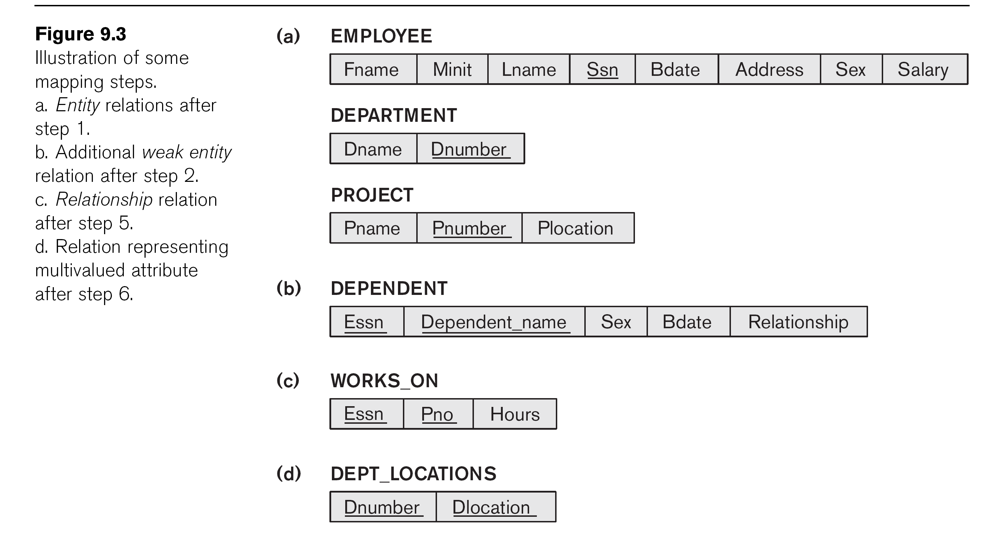
1. Mapping of Strong Entity sets
Relations EMPLOYEE, DEPARTMENT, and PROJECT
Additional attributes will be added to these tables in later mapping steps

Slide 7
Normalization
Process of reorganizing data in a database so that it meets two basic requirements:
There is no redundancy of data
all data is stored in only one place
Data dependencies are logical
all related data items are stored together.
Normalization is important for
To reduce redundancy so storage space
To improve performance
Consistent result

Slide 8
Anomaly : Insertion, Deletion, UpdatioN
ROLL | Sem | SGPA | NAME
102 | 1 | 7.8 | XYZ
102 | 2 | 7.9 | XYZ
102 | 4 | 8.5 | XYZ
103 | 8 | 8.0 | ABC
103 | 7 | 4.5 | ABC
ROLL | Sem | SGPA
102 | 1 | 7.8
102 | 2 | 7.9
102 | 4 | 8.5
103 | 8 | 8.0
103 | 7 | 4.5
ROll | Name
102 | XYZ
103 | ABC
102 | 1 | 7.8 | XYZ
102 | 2 | 7.9 | XYZ

Slide 9
1 NF
First normal form (1NF)
Each cell must contain only a single (atomic) value.
Every column in the table must be uniquely named.
All values in a column must pertain to the same domain.

Slide 11
1 NF
Emloyee (SSN, B_Date, Name(Fname,M_Name,L_name), Aaddress, salary, sex)
Name is composite not atomic
So not in First normal form (1NF)
After conversion
Emloyee (SSN, B_Date, F_name,M_Name,L_name, Aaddress, salary, sex)

Slide 12
2: Mapping of Weak Entity Sets
For each weak entity set W
which may have partial identity attribute
Related to the strong entity set E
create a relation R for all attribute of W
Include PK of strong entity (E) in to W and set the foreign key
The PK of R is the combination of the primary key(s) of the Strong Entity(s) and the partial key of the weak entity type W, if any.

Slide 14
2: Mapping of Weak Entity Sets
Relation for DEPENDENT
Include the primary key SSN of the EMPLOYEE relation as a foreign key attribute of DEPENDENT (renamed to ESSN in Fig.).
The primary key of DEPENDENT is the combination
{ESSN, DEPENDENT_NAME}
because DEPENDENT_NAME is the partial key of DEPENDENT.
FK

Slide 15
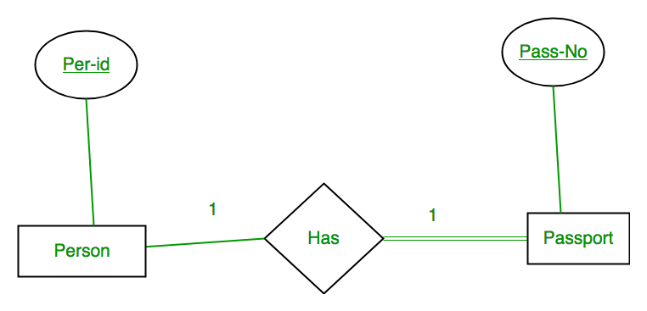
3. Mapping of Binary 1:1 Relationship
For each binary 1:1 relationship type R in the ER schema, identify the relations S and T that correspond to the entity types participating in R
E.g.
A person has 0 or 1 passport number and Passport is always owned by 1 person. So it is 1:1 cardinality with full participation constraint from Passport

Slide 16
3. Mapping of Binary 1:1 Relationship
First Convert each entity and relationship to tables.
Person table corresponds to Person Entity with key as Per-Id.
Passport table corresponds to Passport Entity with key as Pass-No.
Has Table represents relationship between Person and Passport (Which person has which passport).
So it will take attribute Per-Id from Person and Pass-No from Passport.

Slide 17
3. Mapping of Binary 1:1 Relationship (Cont)
First Convert each entity and relationship to tables.
Person table corresponds to Person Entity with key as Per-Id.
Passport table corresponds to Passport Entity with key as Pass-No.
Has Table represents relationship between Person and Passport (Which person has which passport).
So it will take attribute Per-Id from Person and Pass-No from Passport.

Slide 18
3. Mapping of Binary 1:1 Relationship (Cont)
Person |  |  | Has |  |  | Passport
Per-Id |  |  | Per-Id | Pass-No |  | Pass-No
PR1 |  |  | PR1 | PS1 |  | PS1
PR2 | – |  | PR2 | PS2 |  | PS2 | –
PR3 | –

Slide 19
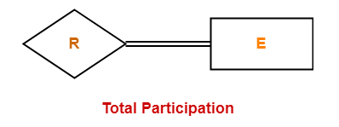
Participation in 1:1 Relationship
Total Participation-
each entity in the entity set must compulsorily participate in at least one relationship instance in that relationship set.
also called as mandatory participation.
is represented using a double line between the entity set and relationship set.

Slide 20
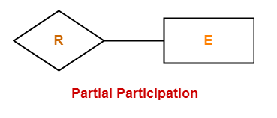
Participation in 1:1 relationship
Partial Participation-
each entity in the entity set may or may not participate in the relationship instance in that relationship set.
also called as optional participation.
Partial participation is represented using a single line between the entity set and relationship set.

Slide 21
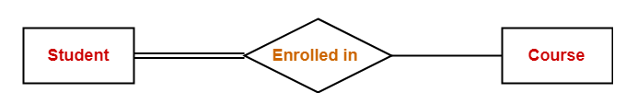
Participation in 1:1 relationship
Double line between the entity set “Student” and relationship set “Enrolled in” signifies total participation.
It specifies that each student must be enrolled in at least one course
There is a possibility that Course is not selected by any student

Slide 22
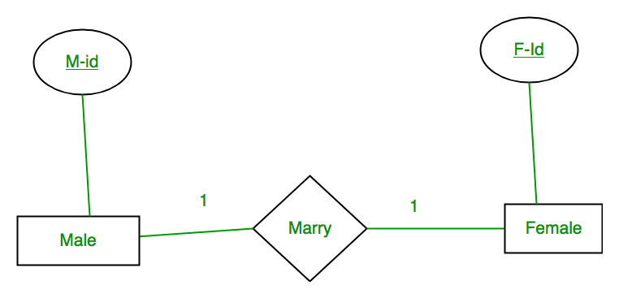
Three types of Participation in Binary 1:1 Relationship
One Entitiy set participation is Total
None of thee Entity set participation is Total
Both Entity set participation is Total

Slide 23
Total participation of One entity set in Binary 1:1 Relationship
Foreign Key approach (One of the Relationship is Total)
Choose one of the relations (say S) and include the PK of T as foreign key in S
(it is better to choose an entity set with total participation in R as S
Person |  |  | Has |  |  | Passport
Per-Id | Pass-No |  | Per-Id | Pass-No |  | Pass-No
PR1 | PS1 |  | PR1 | PS1 |  | PS1
PR2 | PS2 |  | PR2 | PS2 |  | PS2 | –
PR3 | –

Slide 24
Total participation of One entity set in Binary 1:1 Relationship
Foreign Key approach (One of the Relationship is Total)
Choose one of the relations (say S) and include the PK of T as foreign key in S
(it is better to choose an entity set with total participation in R as S
Person |  |  | Has |  |  | Passport
Per-Id | Pass-No |  | Per-Id | Pass-No |  | Pass-No | Per-Id
PR1 | PS1 |  | PR1 | PS1 |  | PS1 | PR1
PR2 | PS2 |  | PR2 | PS2 |  | PS2 | PR2
PR3 | –

Slide 26
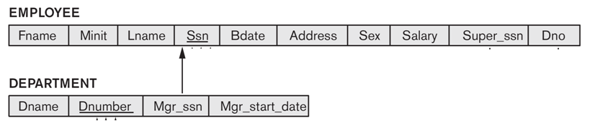
Total participation of One entity set in Binary 1:1 Relationship
In Example
MANAGES is 1:1 relationship with one total participation
DEPARTMENT has Total participation in the relationship
Mgr_SSN of DEPARTMENT is foreign key referencing EMPLOYEE
Attributes of MANAGES become attributes of DEPARTMENT
fk to department
Manages (mng_ssn, Dept_No, start_date)
FK to Employee

Slide 27
Approach 2:
Merged relation option:
Merge the two entity types and the relationship into a single relation (possible when both participations are total).
Approach 3:
Cross-reference or relationship relation option (Both Entity Partial Participation)
Set up a third relation R for cross-referencing the primary keys of the two relations S and T representing the entity types
Example : Next Slide

Slide 28
Partial participation of Both entity set in Binary 1:1 Relationship
some males and some females do not marry
If we merge 3 tables into 1, temp(M_id,F_Id)
for some {M-Id, F-Id) will be NULL.
So we can’t merge all three tables into 1.
Convert into 2 tables without NULL?
Male(M_Id) Temp2(M_id,Fid)
Female(F_ID) Temp3(F_ID,M_ID)
Convert into 2 tables without NULL?
Male(M_Id) Temp2(M_id,Fid)
Male |  |  | Marry |  |  | Female
M-Id |  |  | M-Id | F-Id |  | F-Id
M1 | – |  | M1 | F2 |  | F1 | –
M2 | – |  | M2 | F1 |  | F2 | –
M3 | – |  |  |  |  | F3 | –

Slide 30
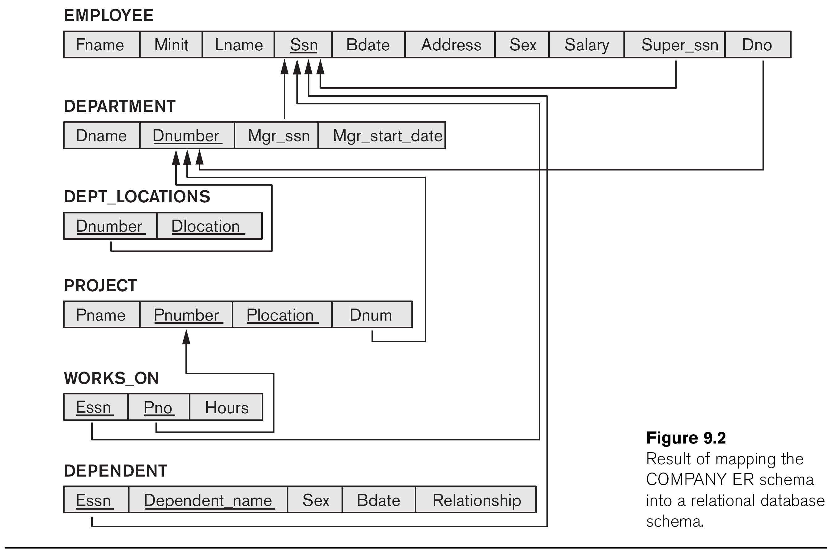

Slide 31
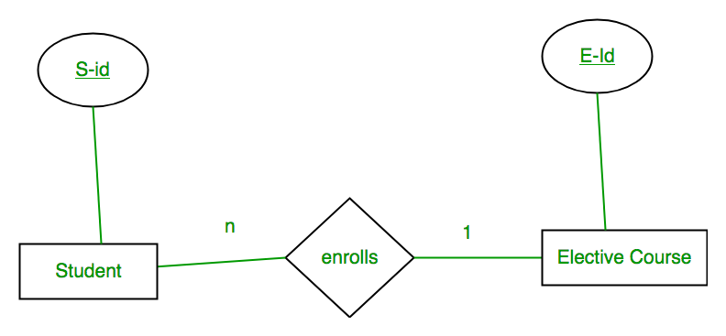
Mapping of Binary 1:N Relationship
S-Id is not repeating in Enrolls Table
So it can be considered as a key of Enrolls table.
Both Student and Enrolls Table’s key is same; we can merge it as a single table.
Tab1 (S_Id, E_ID)…… E_ID Foreign Key
Tab2(E_Id)
Student |  |  | Enrolls |  |  | Elective_Course
S-Id | E-Id |  | S-Id | E-Id |  | E-Id
S1 | E1 |  | S1 | E1 |  | E1 | –
S2 | E2 |  | S2 | E2 |  | E2 | –
S3 | E1 |  | S3 | E1 |  | E3 | –
S4 | E1 |  | S4 | E1

Slide 32
Mapping of Binary 1:N Relationship
For each regular binary 1:N relationship type R, identify the relation S that represent the participating entity type at the N-side of the relationship type.
Include as foreign key in S the primary key of the relation T that represents the other entity type participating in R.
Include any simple attributes of the 1:N relation type as attributes of S.

Slide 34
Mapping of Binary 1:N Relationship
WORKS_FOR, CONTROLS, and SUPERVISION.
WORKS_FOR :
include the PK DNUMBER of the DEPARTMENT relation as FK in the EMPLOYEE relation and call it DNO
CONTROLS:
Include PK DNUMBER of DEPARTMENT as FKin PROJECT and call it DNUM.
SUPERVISION:
Include the PK SSN of EMPLOYEE as FK in EMPLOYEE itself and call it SuperSSN (this is a recursive relationship)

Slide 35
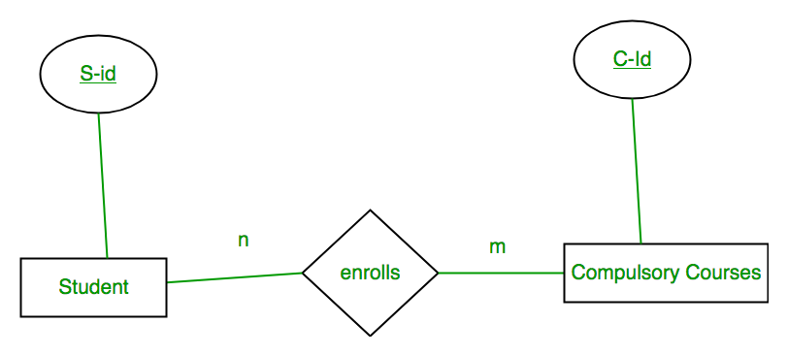
Mapping of Binary M:N Relationship
Student |  |  | Enrolls |  |  | Compulsory_Courses
S-Id |  |  | S-Id | C-Id |  | C-Id
S1 | – |  | S1 | C1 |  | C1
S2 |  |  | S1 | C2 |  | C2 | –
S3 | – |  | S3 | C1 |  | C3 | –
S4 | – |  | S4 | C3 |  | C4 | –
 |  |  | S4 | C2
 |  |  | S3 | C3

Slide 36
Mapping of Binary M:N Relationship
For each regular binary M:N relationship type R, create a new relation S to represent R.
Include as foreign key attributes in S the primary keys of the relations that represent the participating entity types; their combination will form the primary key of S.
Also include any simple attributes of the M:N relationship type (or simple components of composite attributes) as attributes of S.

Slide 38
Mapping of Binary M:N Relationship
WORKS_ON :
Relation WORKS_ON
The primary keys of PROJECT and EMPLOYEE are foreign keys in WORKS_ON and renamed PNO and ESSN, respectively.
Attribute HOURS in WORKS_ON represents the HOURS attribute of the relation type.
The primary key of WORKS_ON is the combination {ESSN, PNO}.

Slide 39
Mapping of Multivalued attributes.
For each multivalued attribute A, create a new relation R.
This relation R will include an attribute corresponding to A, plus the primary key attribute K (as a foreign key in R) of the relation that represents the entity type that has A as an attribute.
The primary key of R is the combination of A and K. If the multivalued attribute is composite, we include its simple components.

Slide 41
Mapping of Multivalued attributes.
The MV Attribute will be converted into Binary 1:N Relationship
11
11
Conversion follow rules for 1:N
The relation DEPT_LOCATIONS(DNUMBER,DLOCATION) is created.
The attribute DLOCATION represents the multivalued attribute Locations of DEPARTMENT
while DNUMBER is foreign key to the DEPARTMENT relation
The primary key of DEPT_LOCATIONS is the combination of {DNUMBER, DLOCATION}.
Department
n
Location
1
has

Slide 42
Mapping of N-ary Relationship Types.
Technique 1:
For each n-ary relationship type R, where n>2, create a new relationship relation S to represent R.
Include as foreign key attributes in S the primary keys of the relations that represent the participating entity types.
Also include any simple attributes of the n-ary relationship type (or simple components of composite attributes) as attributes of S.
Technique 2:
Convert N-arry relation in to multiple Binary relationship

Slide 43
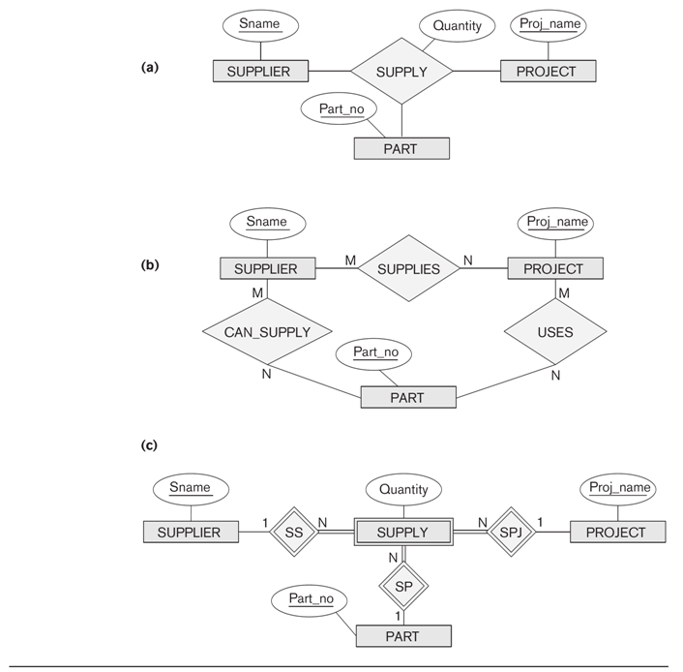

Slide 44
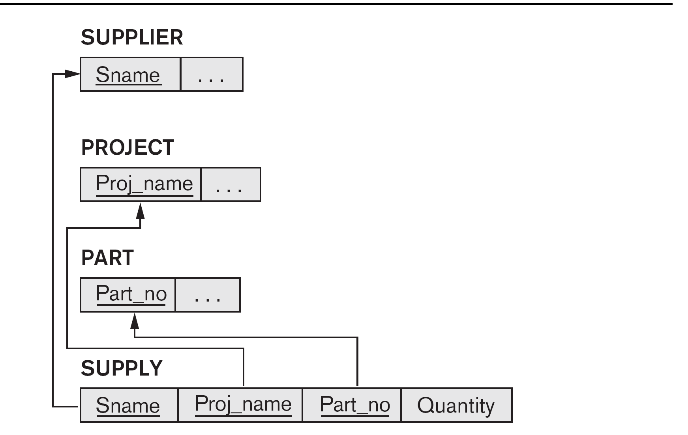
Result of Mapping of N-ary relationship

